Slide 1

“An Intelligent Early Warning System for Software Quality Improvement and Project Management”
Presented by: Maham Nadeem
Roll no: bscs-f19-m58
Section: b-Morning

Slide 2
Introduction
Problem: Unfruitful Development due to late risks and problem detection
Solution
To improve quality, it is important for managers to visualize risks in advance
Early Warning system through Fuzzy Logic – successful in risk assessment
Using ‘dimensional analytic model’ to organize metrics from three different dimensions (Product, Process and Organization)
System will tell root cause of identified risk

Slide 3
Year | Author | Method | Conclusion
1981, 1989, 2000 | Barry Boehm | COCOMO Spiral Model | COCOMO - cost estimation models for most software projects (effort and schedule) Spiral Model – for reducing risk in large projects
1996 | Linda H. Rosenberg | Software Metrics Program | SMP assess risk areas at each phase of the development life cycle.
1995 | NASA | WISE Project Management System. | NASA’s WISE Project Management System uses the internet to provide framework issue management in software.

Slide 4
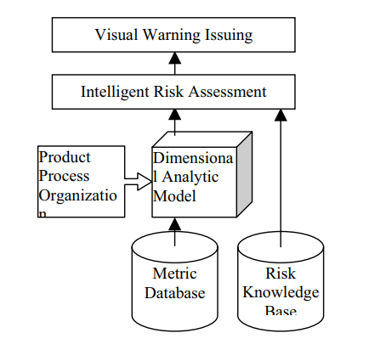
System Architecture:

Slide 5
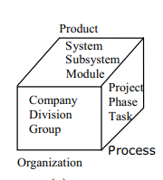

Dimensional Analytical Model For Metric Database:
Base for risk assessment
Metrics db stores software metrics which is used to risk analysis
and warning detection
Product Metrics (System, Subsystem, Module)
Process Metrics (Project, Process, Task)
Organizational Metrics (Company, Division, Group)
Knowledge Base:
Contains number of inference rules about risk detection
across all phases (if-then structures)
e.g., Process Metric based Rule

Slide 6
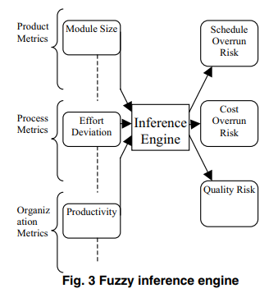
Intelligent Risk Assessment:
Result of fuzzy inference engine which is central part of system
At a particular level, every metrics form set of input for inference engine.
Inference engine apply knowledge base on this set to produce Quality risk, Schedule overrun, Cost overrun.
a) Fuzzy Inputs
b) Apply Fuzzy Rules:
c) Implication Method
d) Aggregation
e) Defuzzification

Slide 7
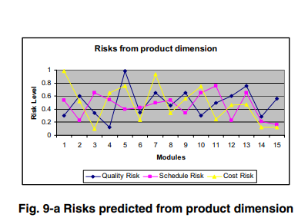
Visual Warning Issuing:
The risks regions can be predicted visually.

Slide 8
Conclusion:
Customizable early warning system for software development.
System is able to detect risks in early phase of development using fuzzy logic.
Differs from traditional risk assessment method due to use of quantifiable aspect (product, process, organization).
Doesn’t only use individual metrics but also their combinations.
Fuzzy logic and neural networks can be used in combination to further enhance fuzzy inference engine in our future research

